Slide 1
MENA CONCENTRATION & HEALTH OUTCOMES
(Michigan only)

Slide 2
Economic risk factors
In census tracts with nonzero MENA concentration, as MENA concentration increases…
Uninsurance is more prevalent
Food insecurity is more prevalent
Housing insecurity is more prevalent

Slide 3
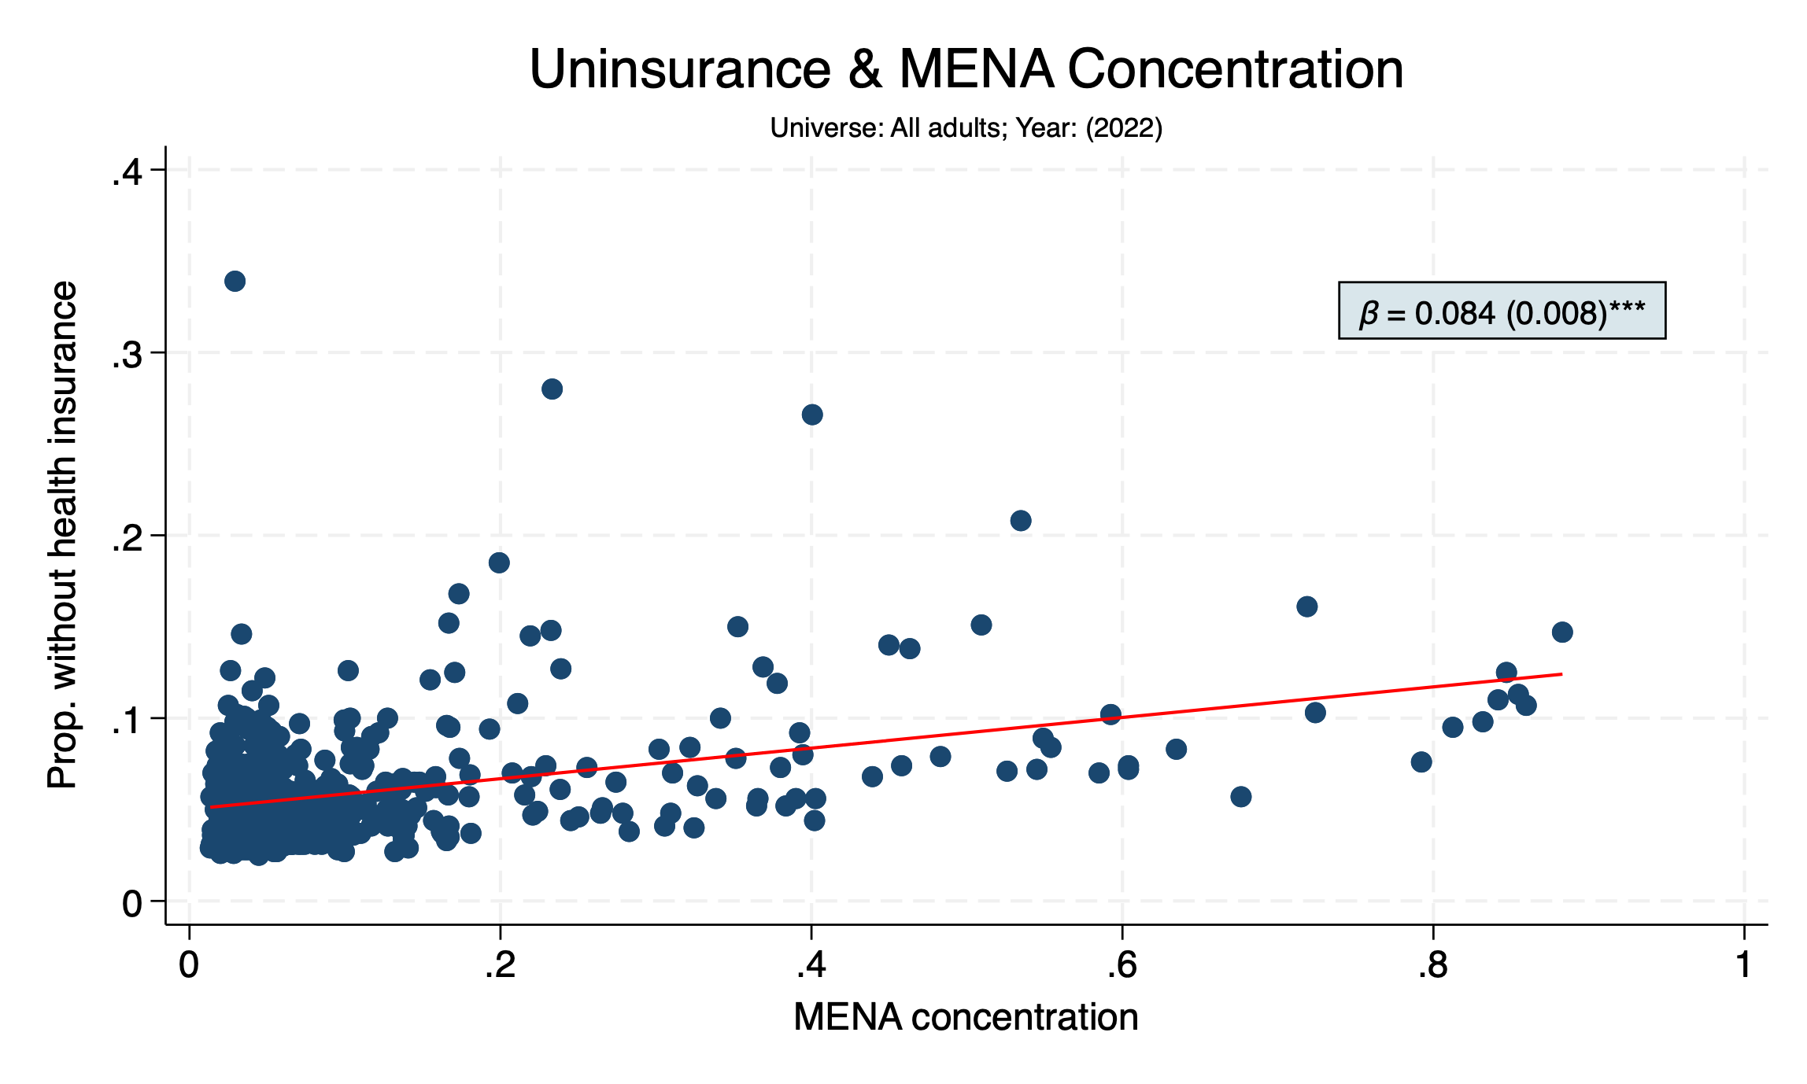

Slide 4
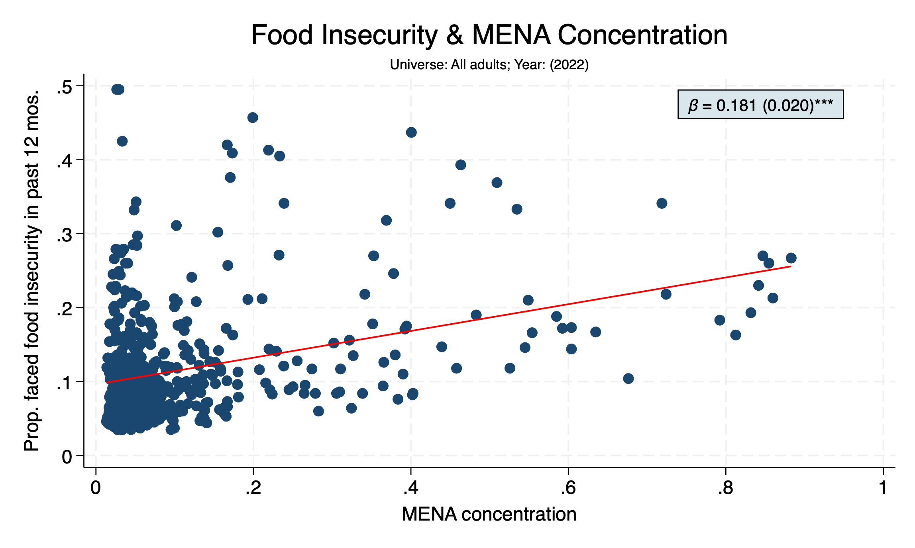

Slide 5
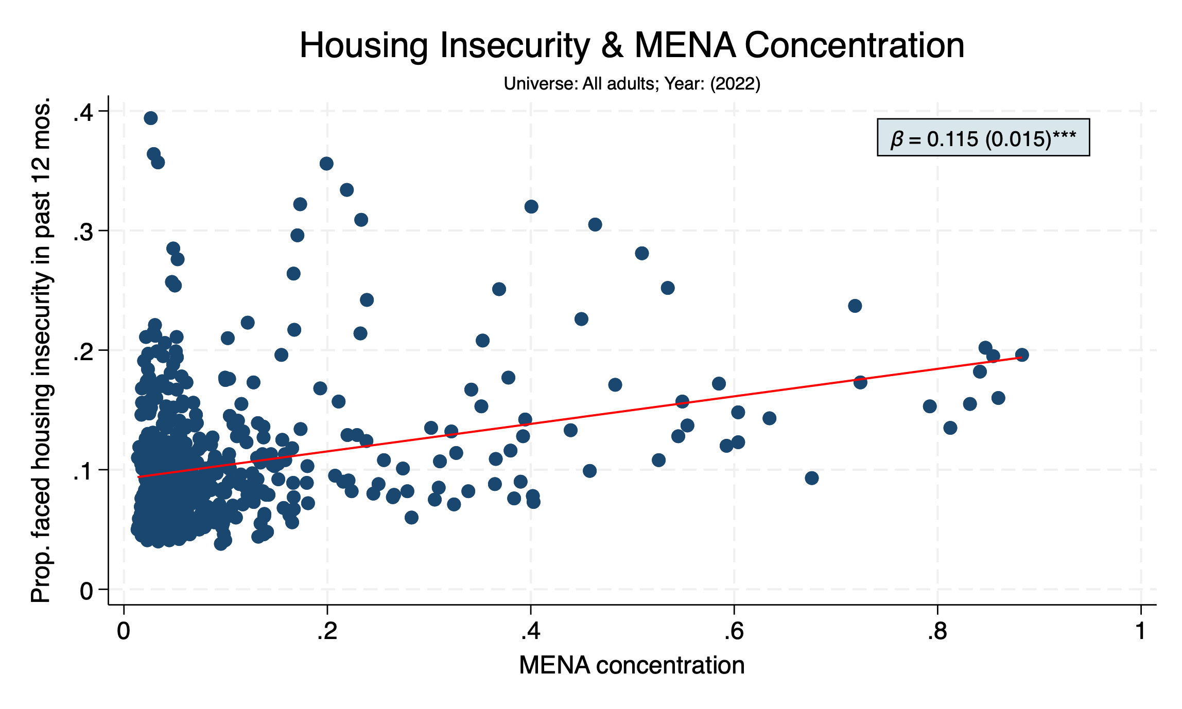

Slide 6
Individual risk factors
In addition to systemic economic factors, the prevalence of individual (“behavioral”) risk factors is higher in tracts with higher MENA concentration
In census tracts with nonzero MENA concentration, as MENA concentration increases…
Individuals are more likely to smoke
Individuals are more likely to report poor quality sleep
Individuals are more likely to report feeling socially isolated

Slide 7
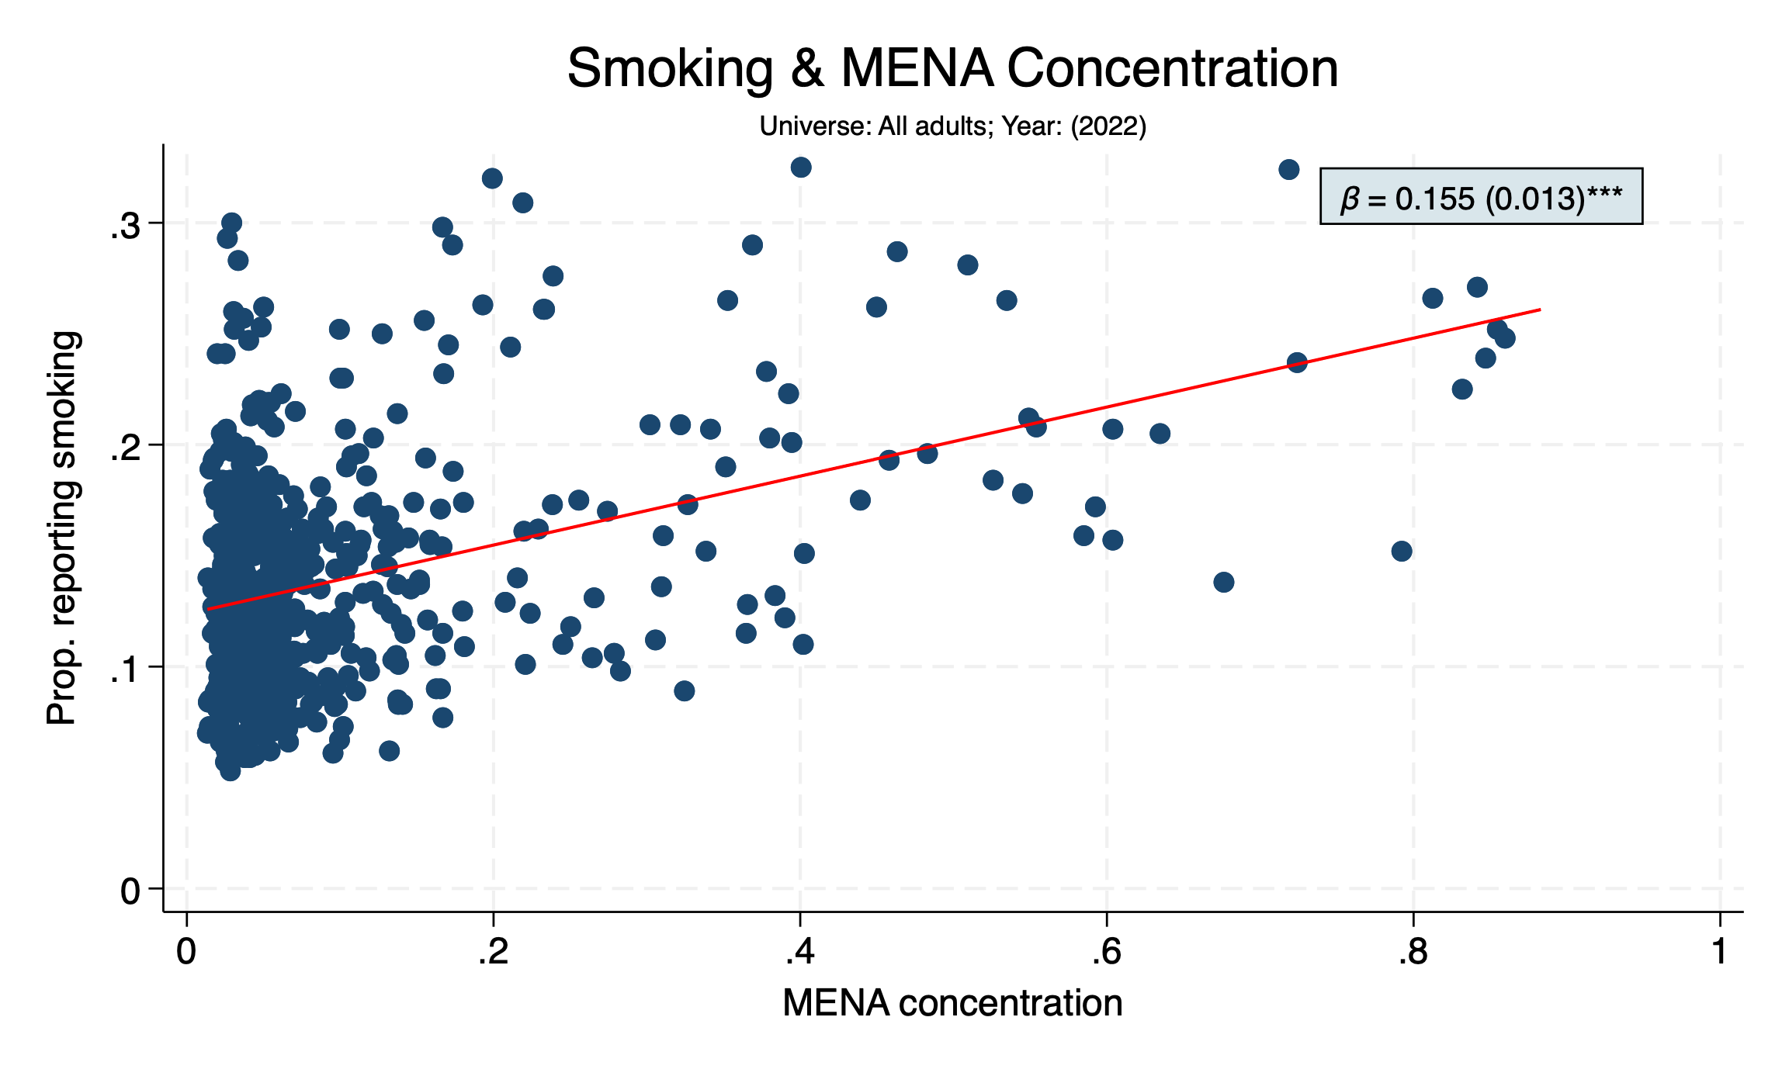

Slide 8
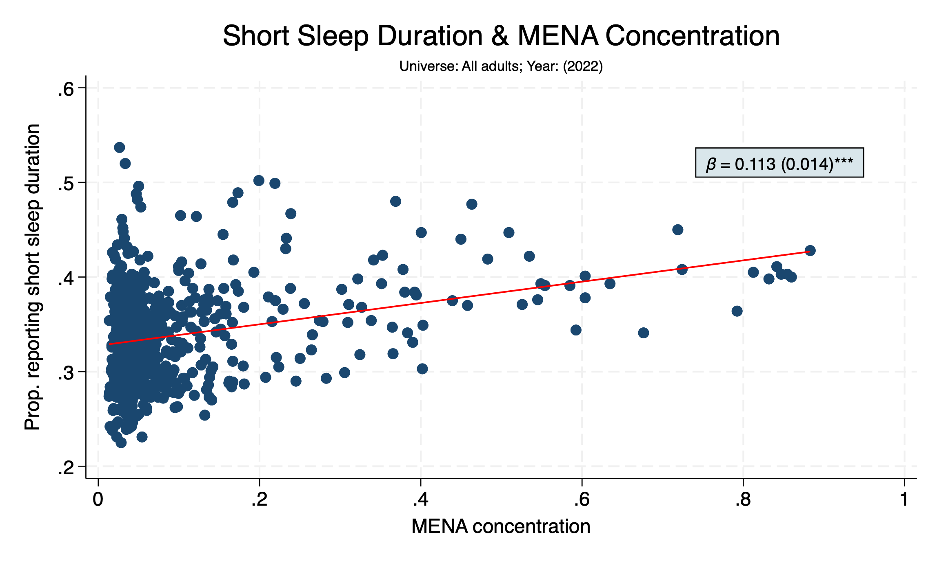

Slide 9
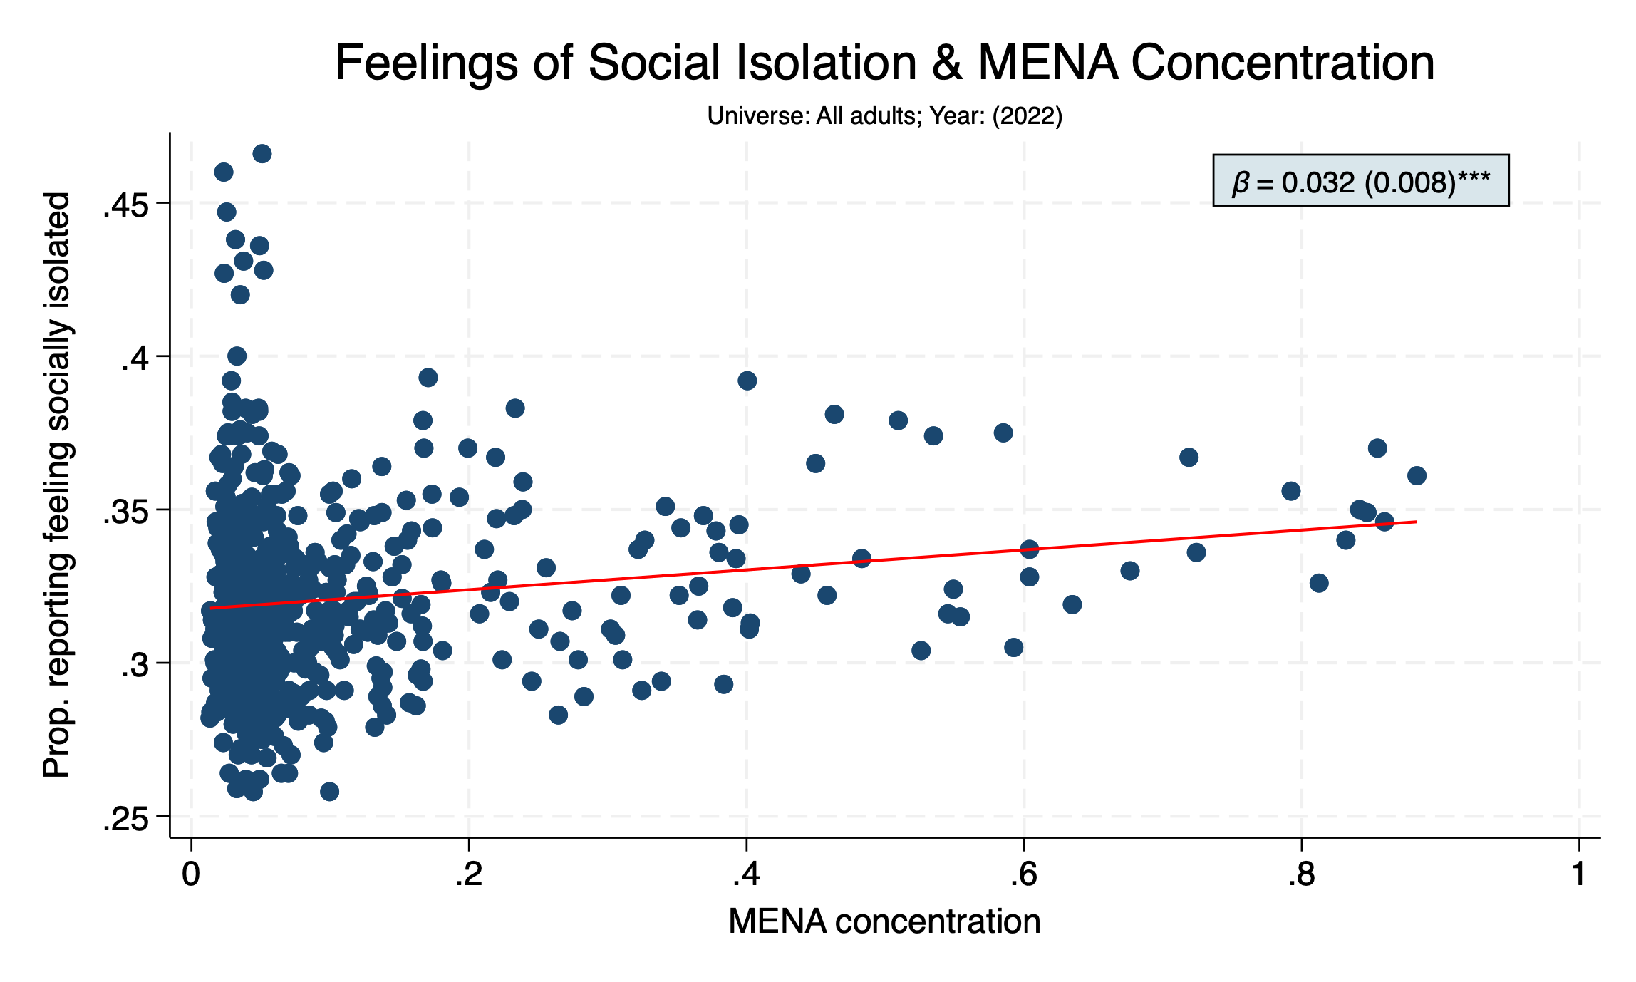

Slide 10
Utilization
Due to the correlation between health risk factors and MENA concentration, we would hope that tracts with higher MENA concentration are seeking more medical care
However, in census tracts with nonzero MENA concentration, as MENA concentration increases, individuals are less likely to…
Visit a PCP for an annual physical
Get screened for colorectal cancer
Get a mammogram
Get cholesterol screening

Slide 11
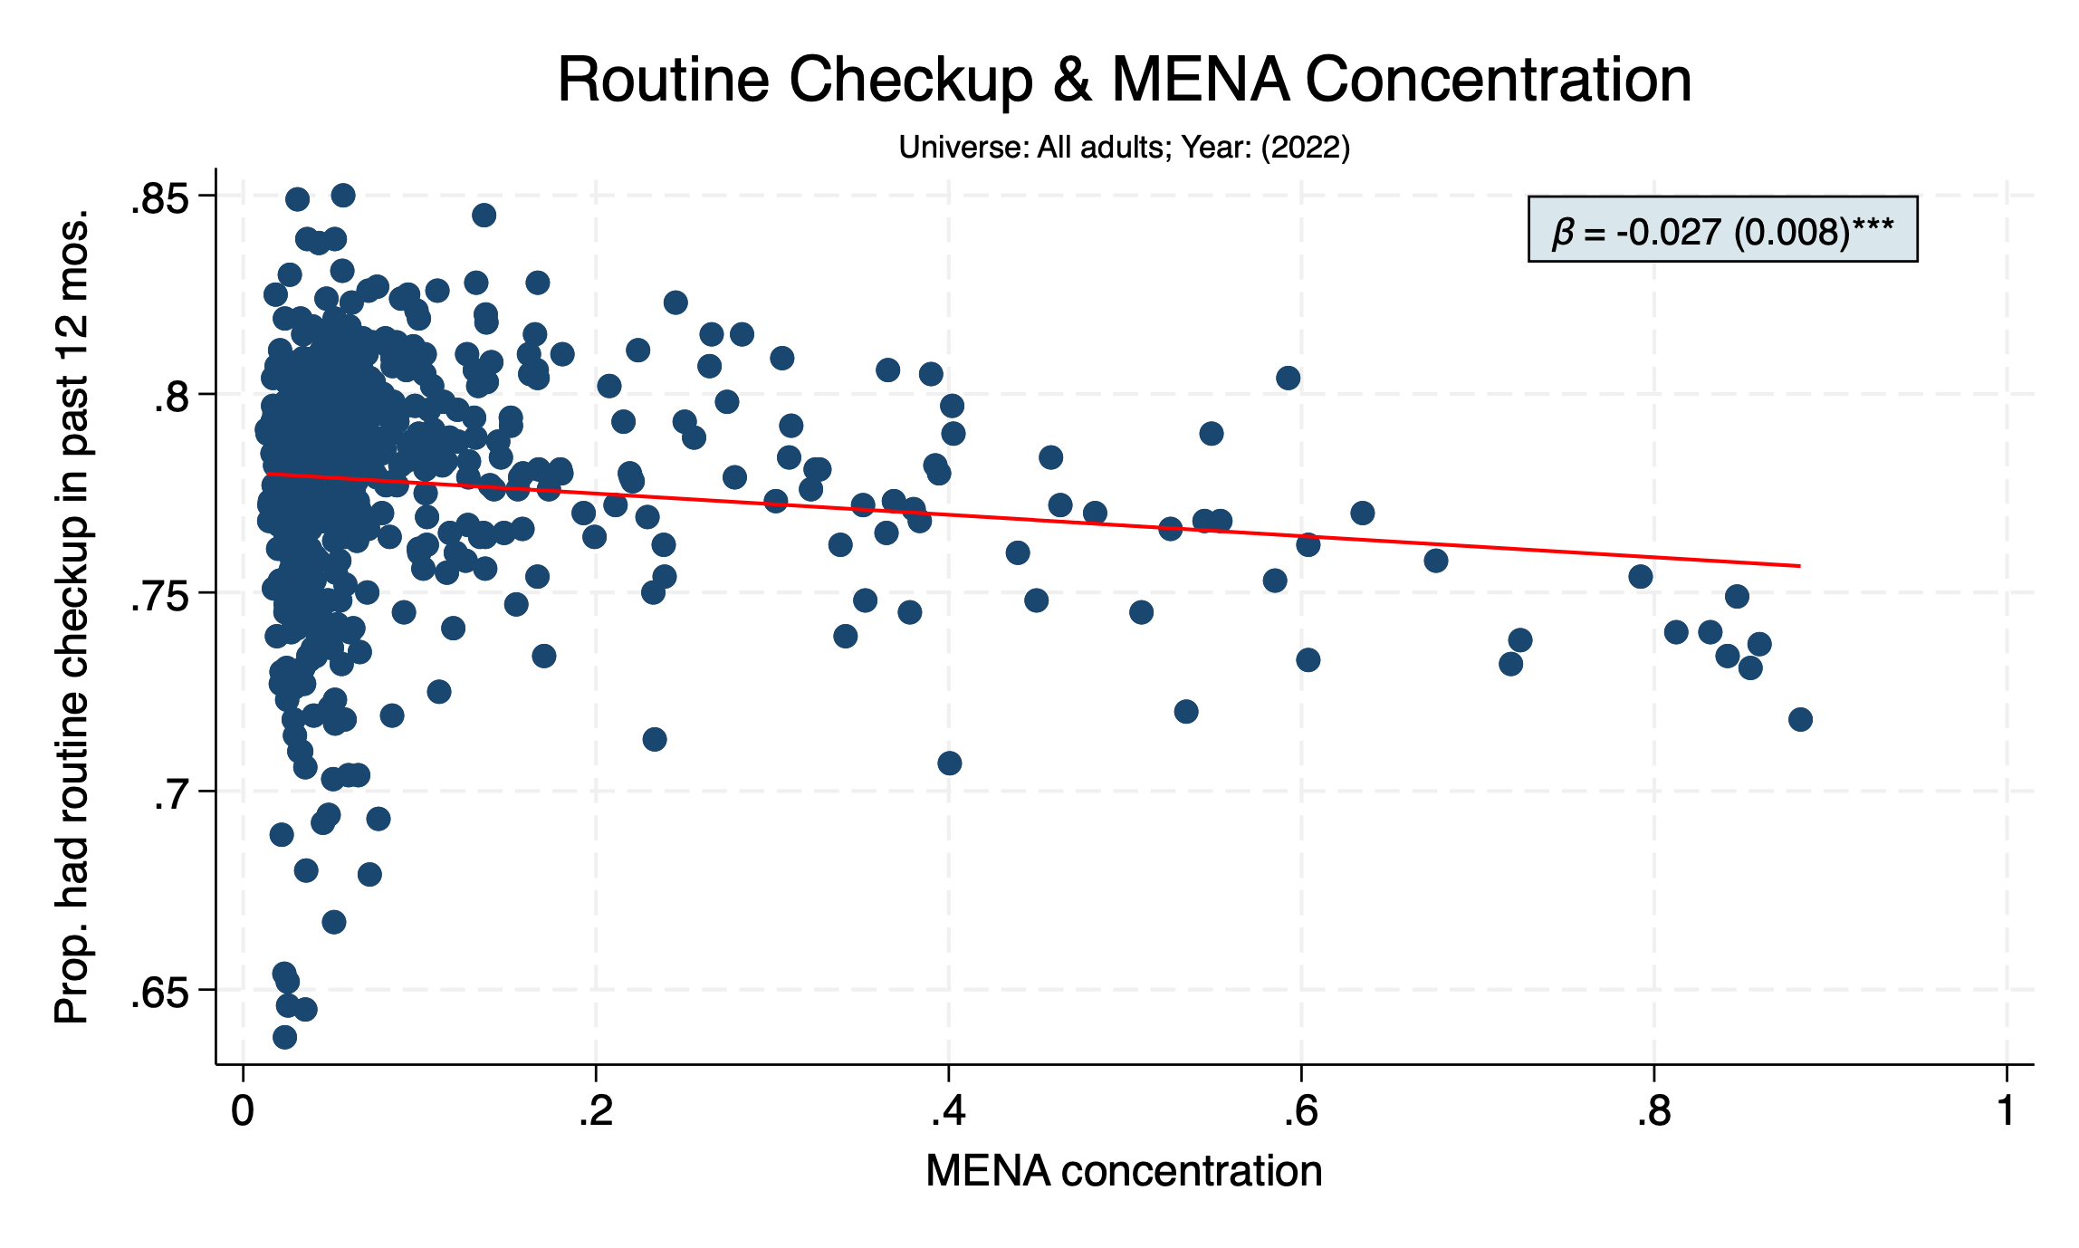

Slide 12
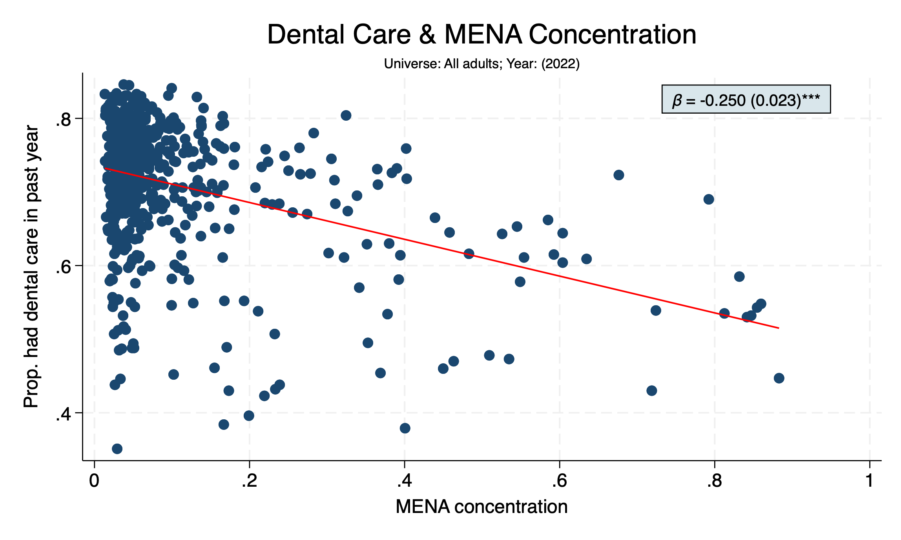

Slide 13
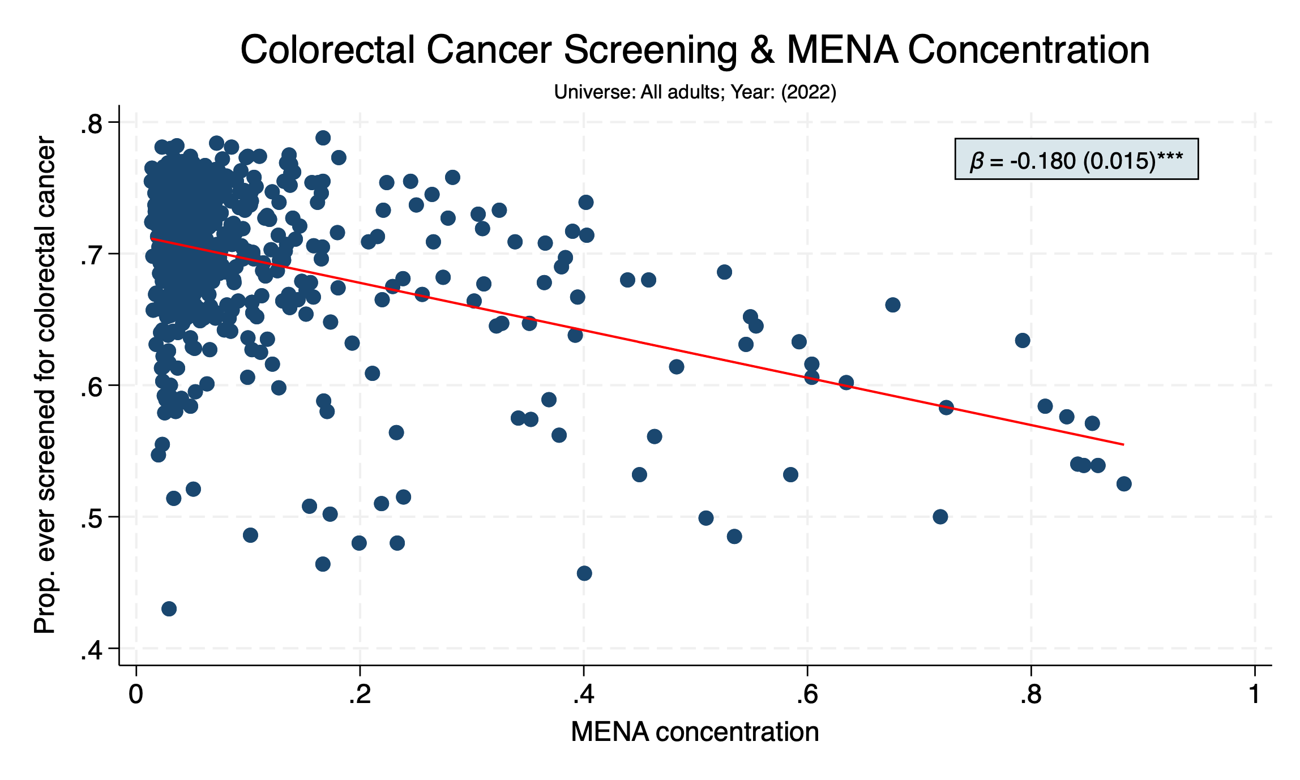

Slide 14
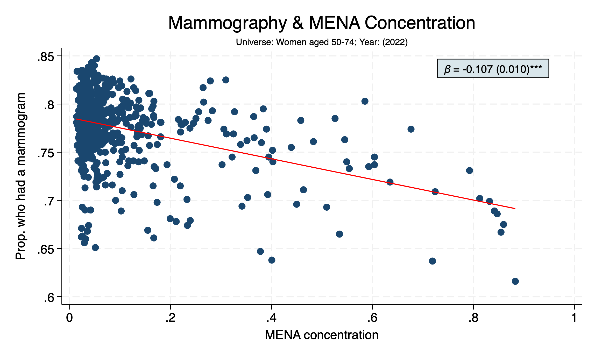

Slide 15
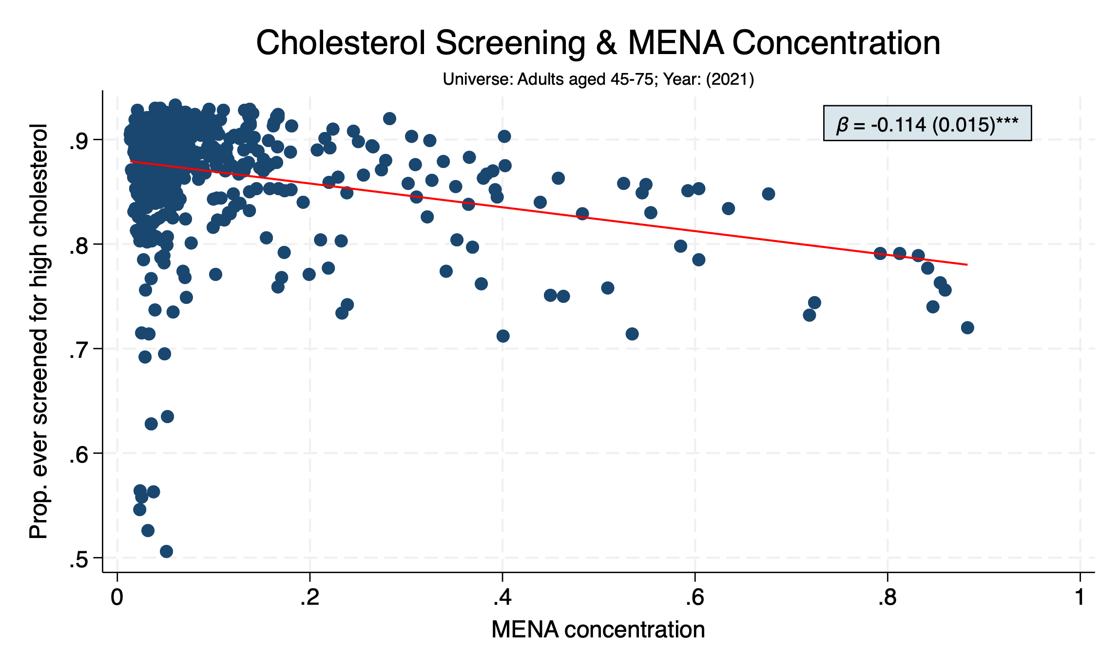

Slide 16
Chronic Health Conditions
The relationships between MENA concentration and various health outcomes reflect the relationships between MENA concentration and risk factors/utilization
In census tracts with nonzero MENA concentration, as MENA concentration increases, individuals are…
More likely to have diabetes
More likely to suffer from respiratory diseases like COPD
More likely to suffer from circulatory diseases like coronary artery disease
Also more likely to have had a stroke
More likely to suffer from depression
More likely to have lost all their teeth
Less likely to have been diagnosed with cancer

Slide 17
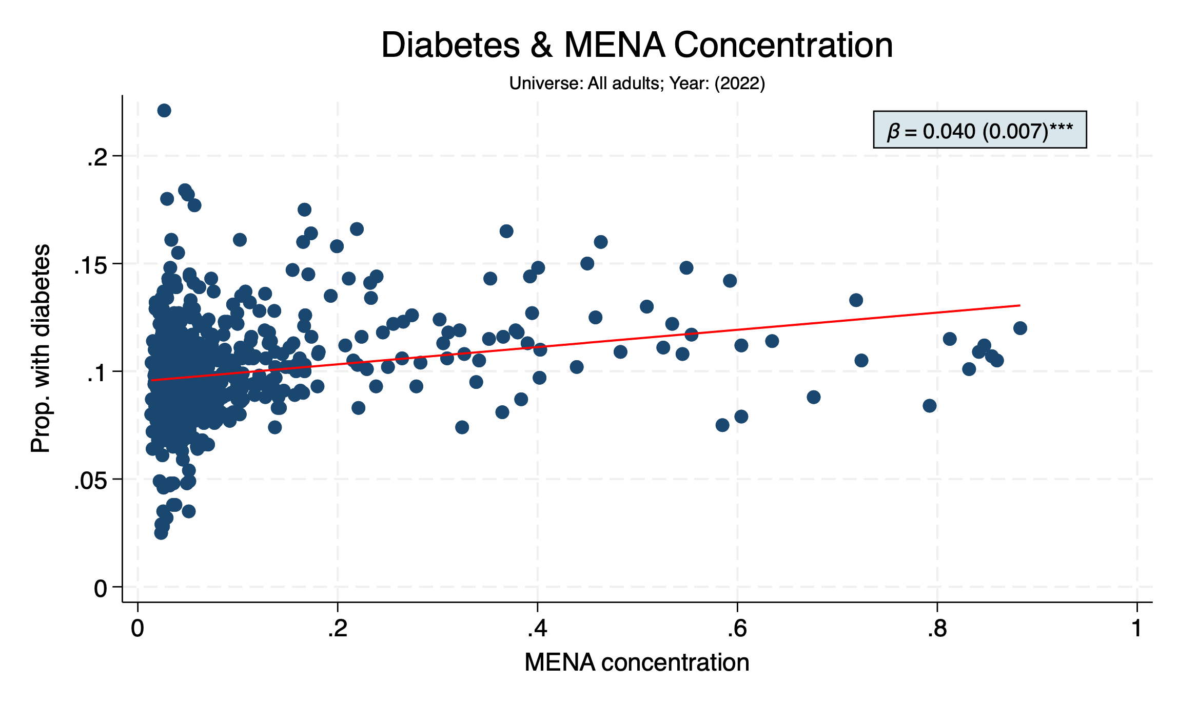

Slide 18
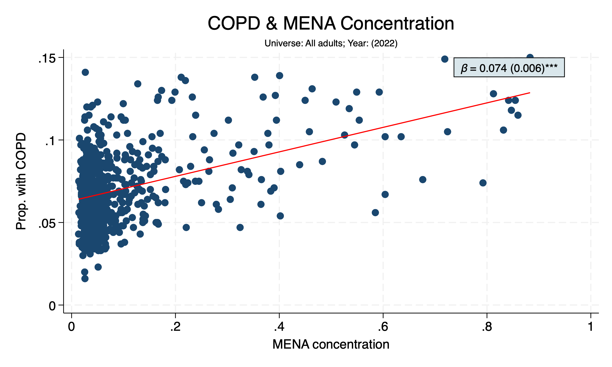

Slide 19
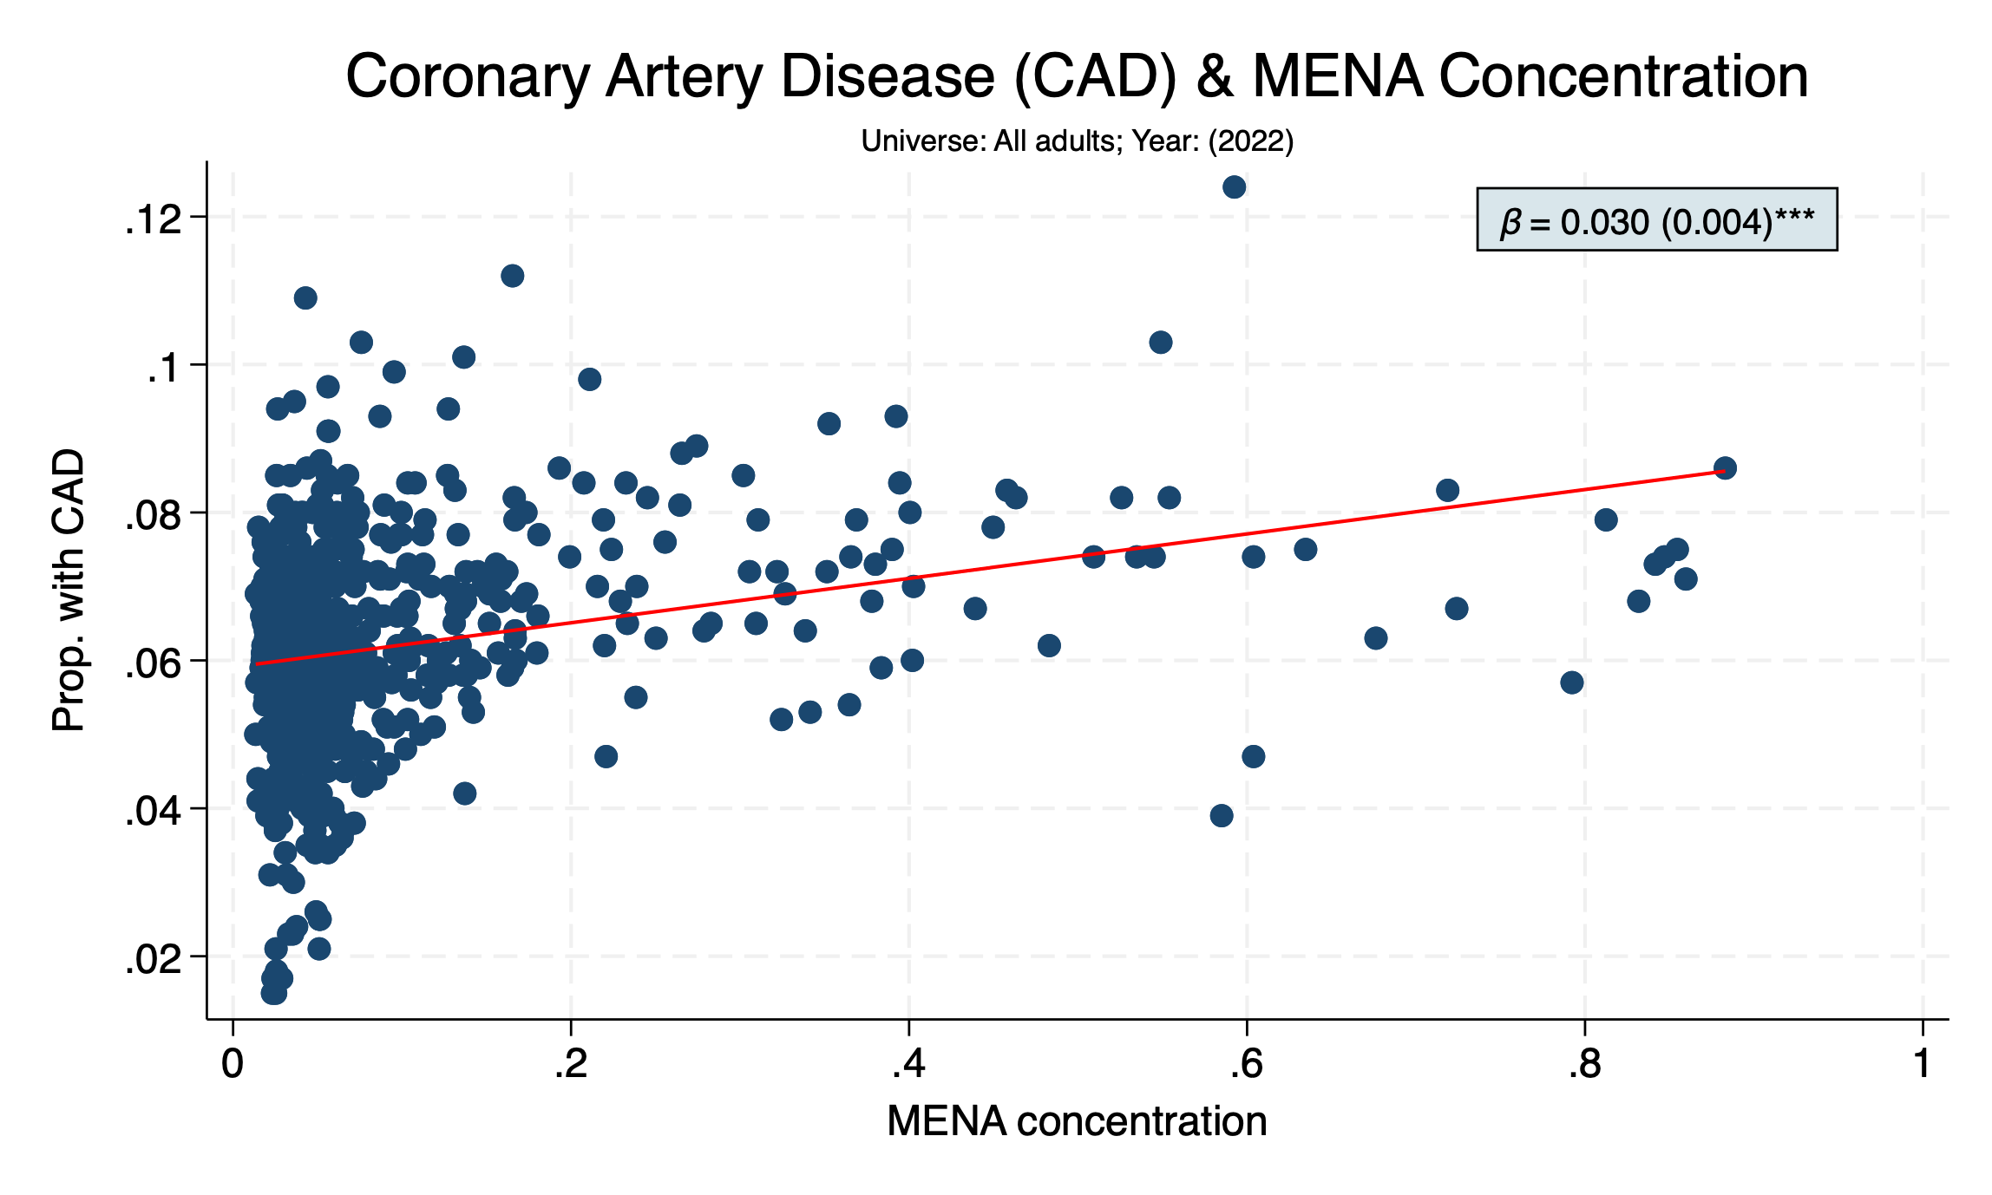

Slide 20
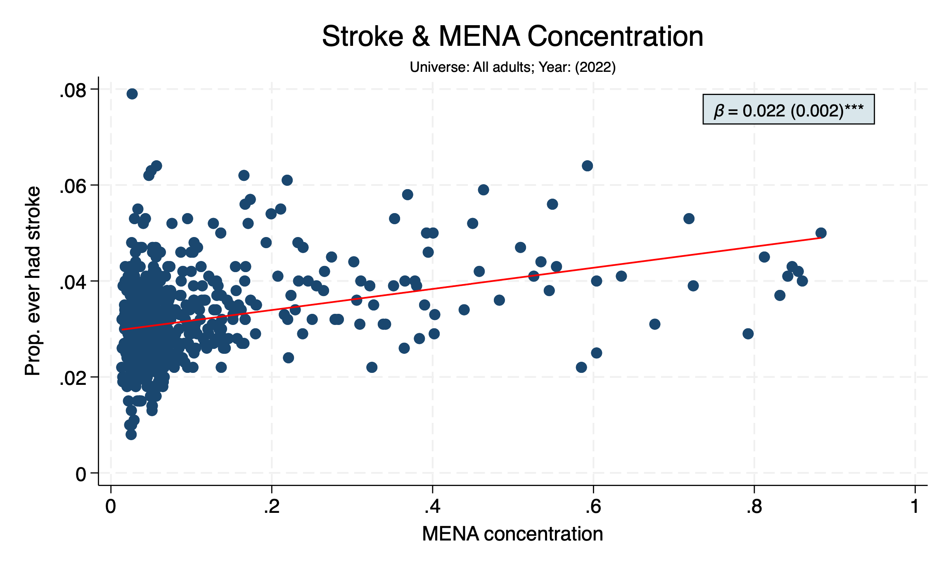

Slide 21
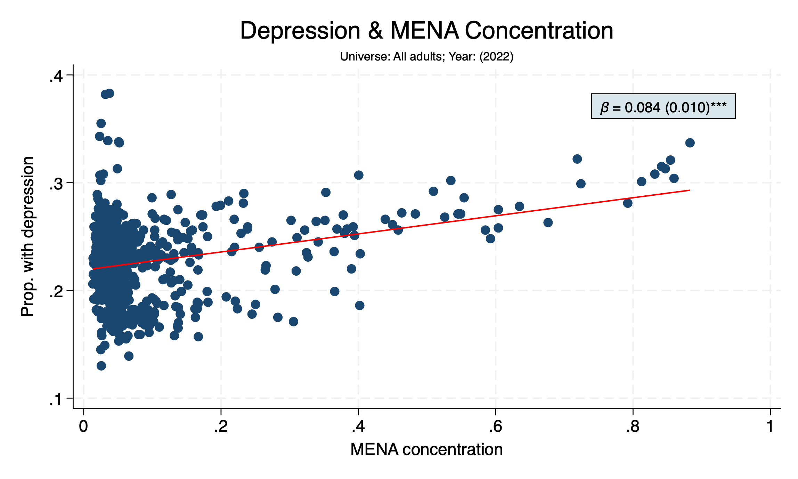

Slide 22
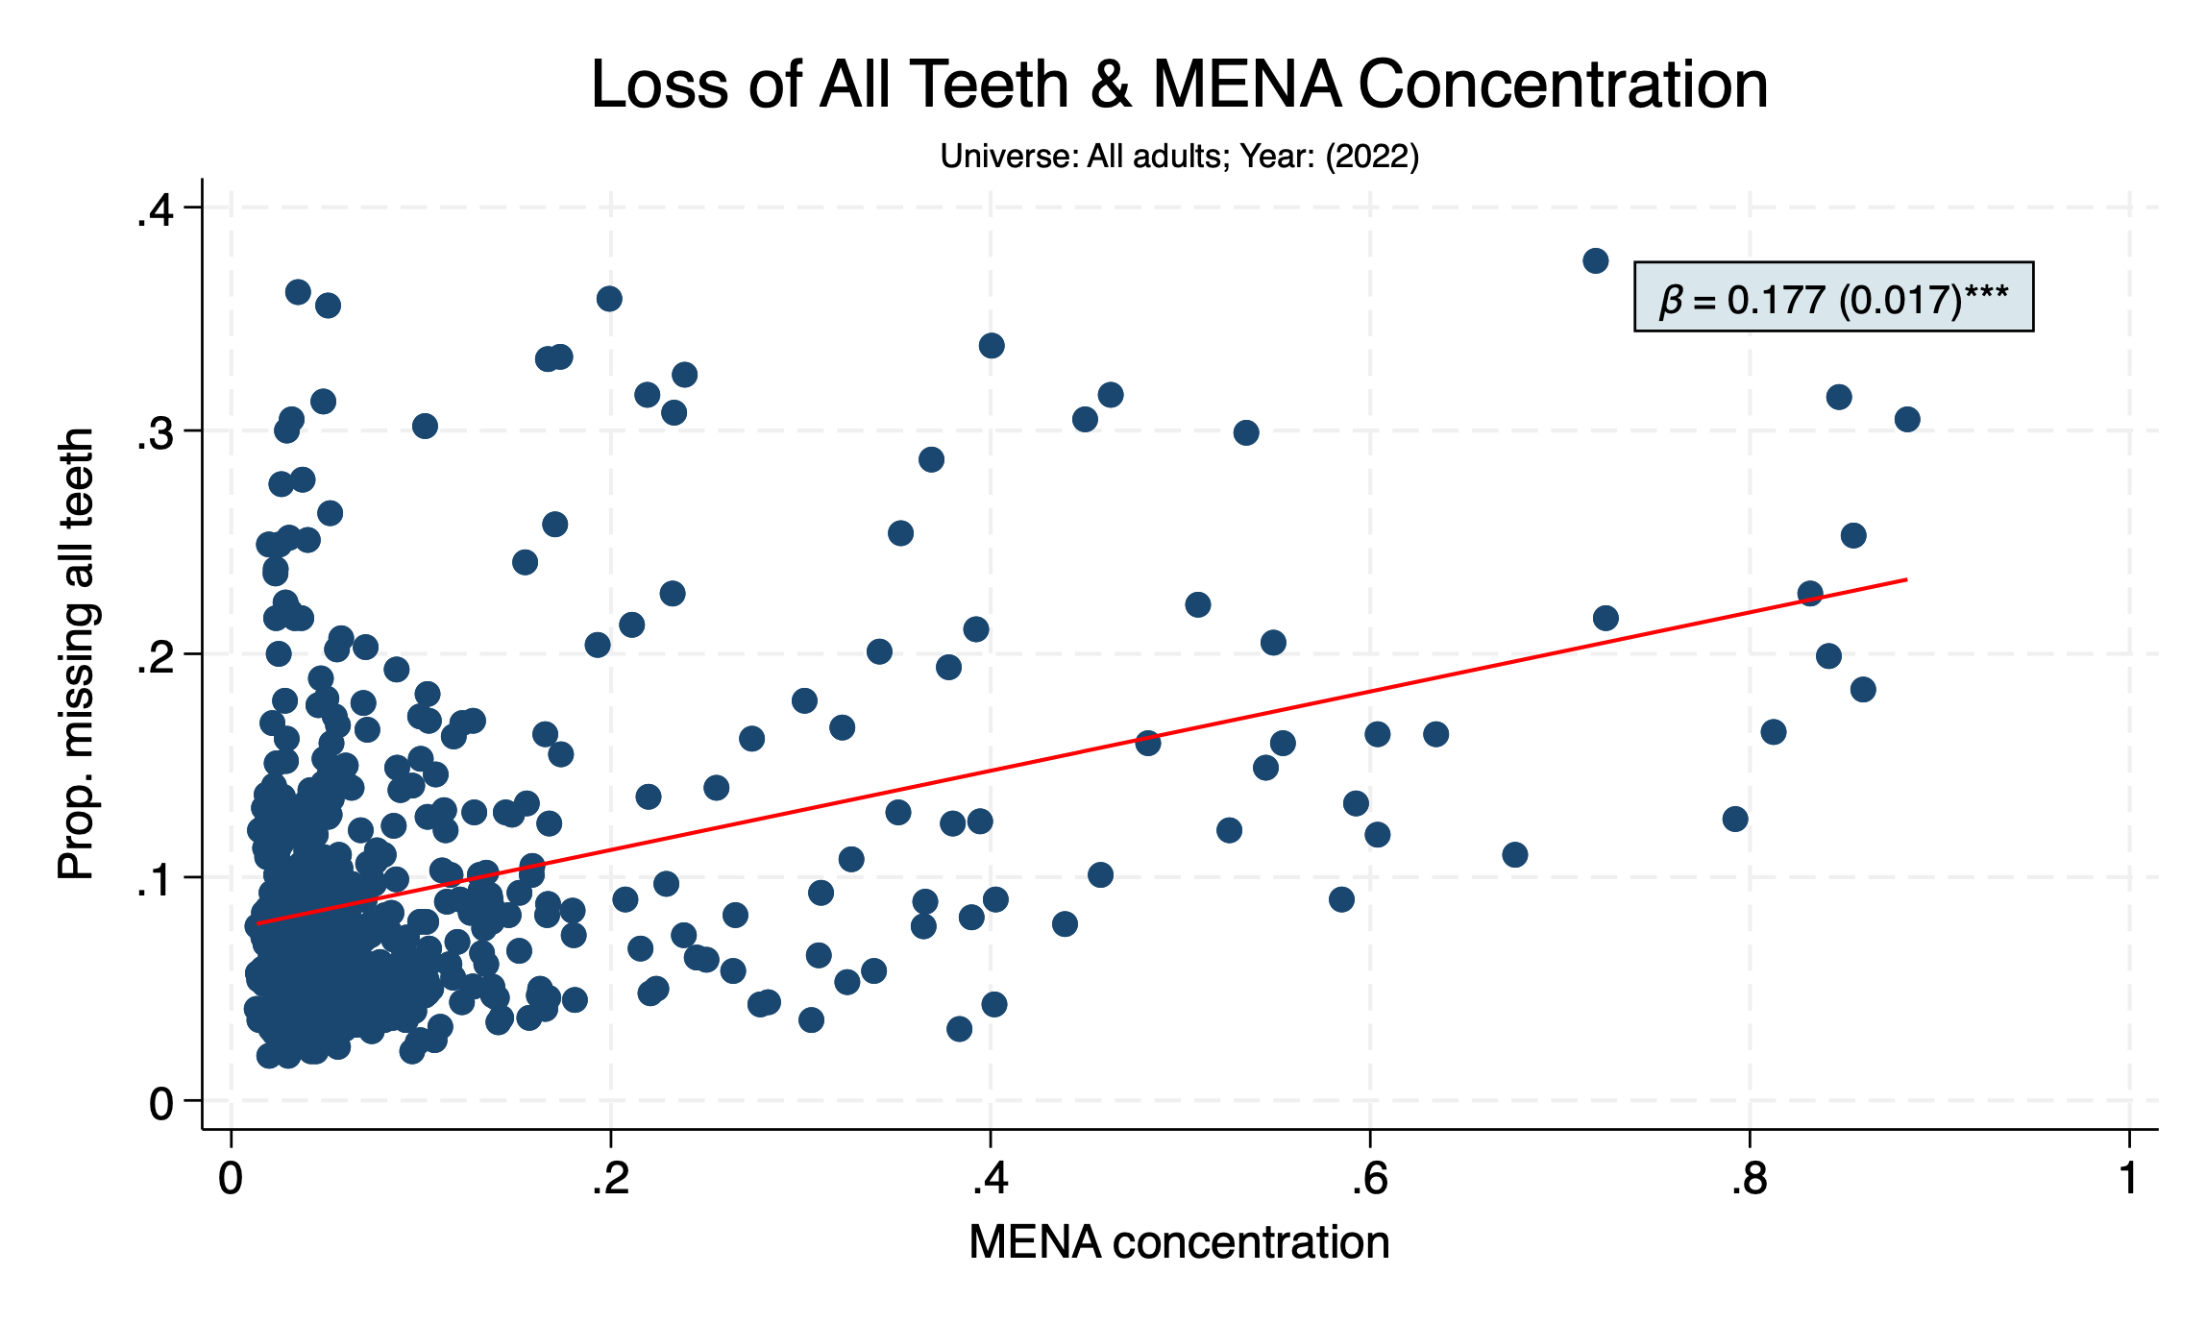

Slide 23
